Slide 1





Cloud Fend
Enhancing Cloud Security with Security Command Center
Presenter: GAURAV ROAKDE Institute: CPC, Gujarat University

Slide 2


Introduction
Cloud security is a crucial aspect of modern computing, ensuring data integrity, confidentiality, and availability. Google Cloud Security Command Center (SCC) is a powerful tool designed to help organizations identify, detect, and mitigate security threats in real time. In this presentation, we introduce Cloud Fend, a project that leverages SCC to enhance security in Google Cloud environments.

Slide 3


Objectives of Cloud Fend
•Identify Application Vulnerabilities: Detect security weaknesses within cloud applications and infrastructure.
•Detect and Investigate Threats: Monitor for anomalies, unauthorized access, and security incidents.
•Mitigate Threats and Vulnerabilities: Implement proactive remediation strategies to prevent cyber threats.
•Ensure Proactive Cloud Security Management: Automate security workflows and enhance cloud resilience.

Slide 4


Why Cloud Security?
Google Cloud SCC provides centralized visibility and control over security risks. Key benefits include:
Unified Security Management: Centralized monitoring and threat detection across GCP resources.
Automated Risk Detection: AI-driven threat intelligence to detect vulnerabilities and suspicious activity.
Compliance and Policy Enforcement: Helps organizations adhere to industry security standards and regulations.

Slide 5


Identifying Application Vulnerabilities
SCC scans cloud workloads and applications to uncover misconfigurations and security gaps. It identifies weak IAM policies, exposed APIs, and unpatched software vulnerabilities.
Real-time risk assessment enables organizations to prioritize critical vulnerabilities.
Example: Detection of public access to storage buckets or misconfigured firewall rules.

Slide 6


Detecting and Investigating Threats
SCC integrates threat intelligence feeds to provide advanced threat detection.
It detects unauthorized access attempts, brute-force attacks, and malicious activity.
The system generates detailed logs for incident analysis using Google Cloud Logging and SIEM tools.
Example: Detecting an attacker attempting to escalate privileges within a GCP environment.

Slide 7

Mitigating Threats & Vulnerabilities
• SCC provides automated security policy enforcement to mitigate risks.
• Organizations can set up alerts and response workflows to remediate threats proactively.
• The Challenge Lab offers a hands-on approach to learning how SCC mitigates real-world security threats.
• Example: SCC automatically revoking unauthorized IAM role assignments to prevent privilege escalation.

Slide 8



Cloud Fend stands out with the following innovative features:
• AI-Driven Anomaly Detection: Uses machine learning models to detect behavioral anomalies.
• Integration with Third-Party SIEM Tools: Enhances security analytics and incident response.
• Custom Security Automation Scripts: Automates mitigation workflows for faster response.
• Example: Automating security incident response using Google Cloud Functions
Unique Aspects of Cloud Fend

Slide 9
Implementation Process
Enable SCC API: Activating SCC in the GCP Console for security monitoring.
Initiate Web Application Scanner: Running automated scans to identify vulnerabilities in hosted applications.
Detect and Manage Threats: Leveraging SCC to analyse security threats and anomalies.
SCC Finding Event Threat Detection: Investigating flagged security events and categorizing risks.
Create Mute Rules: Suppressing known non-critical alerts to enhance focus on high-risk issues.
Analyse and Fix High-Risk Findings: Prioritizing remediation actions for severe vulnerabilities.
Security Scanning for Applications: Running continuous security scans to monitor and address vulnerabilities.
Export Findings to Storage: Archiving security findings for compliance reporting and future analysis.

Slide 10
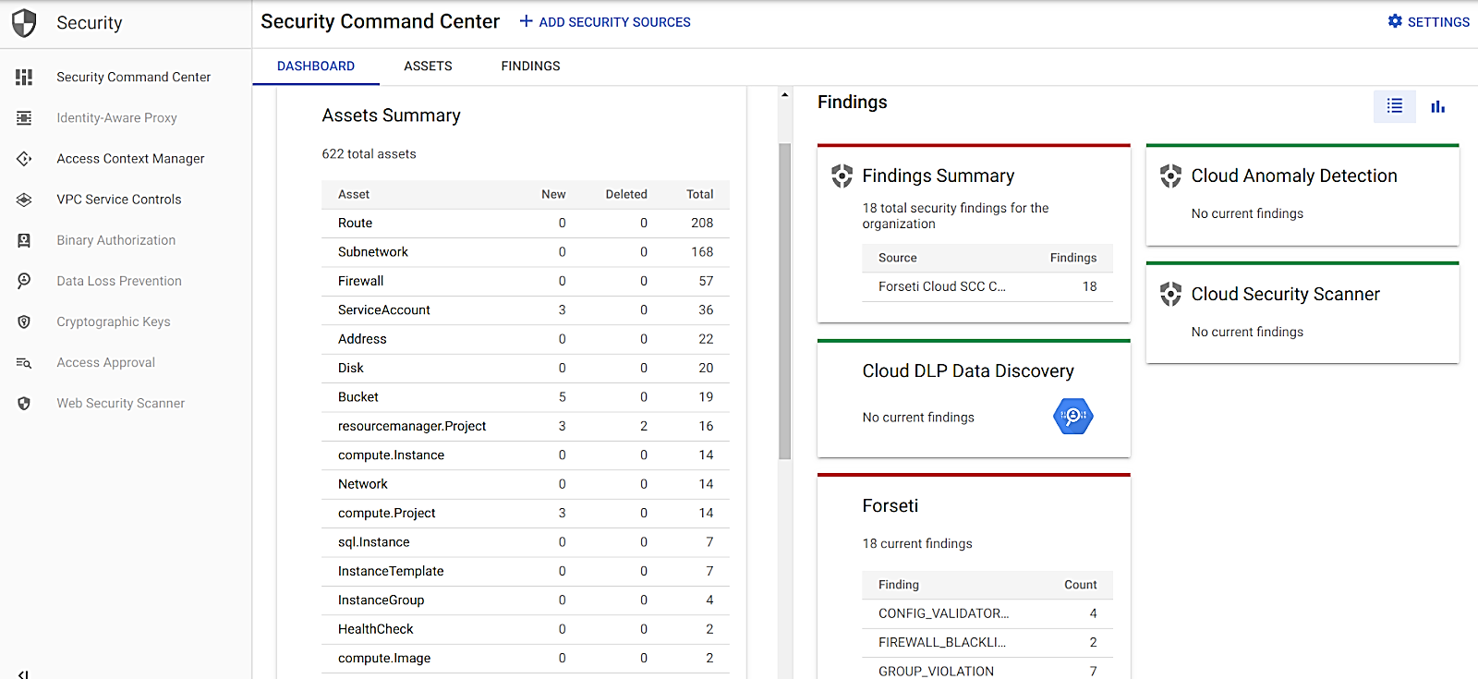
SCC Overview
The Security Command Center provides Respond to simulated attacks, misconfigurations, and threats, Detecting misconfigurations and security breaches, Analyzing security events and mitigating them in real time, Automating security operations using SCC tools.

Slide 11
Future Scope & Enhancements
Enhancing AI-Based Threat Detection: Implementing deep learning models for predictive analytics.
Expanding to Multi-Cloud Security: Adapting SCC methodologies for hybrid cloud environments.
Automating Compliance Monitoring: Using Google Cloud Policy Intelligence for regulatory adherence.
Example: Continuous compliance monitoring with Security Health Analytics.

Slide 12
Conclusion
• Cloud security is essential for protecting digital assets in an evolving threat landscape.
• Security Command Center offers a comprehensive security management platform for Google Cloud users.
• Cloud Fend enhances security visibility, automates threat detection, and strengthens incident response.
• By implementing SCC best practices, organizations can reduce attack surfaces and maintain a secure cloud environment.

Slide 13


THANK YOU

